Slide 1

Boston Crime Data Analysis
Personal Project
Xuanlin Liu

Slide 2
Purpose of making this slide
This is a general projects in which I tried to include all data-related parts, so here I made a brief report to generalize the result, in POWERPOINT format

Slide 3
Brief Conclusion
In this project, I conducted data analysis based on time, locations and incidents, predicting the crimes category based on 89 Features including locations, time, and offense type,then we run K-Fold & grid search to improve the model accuracy, and implemented NLP & Deep Learning to reinforce our model performance. Besides, we employed Time Series Analysis to predict the crime patterns based on a daily basis.

Slide 4
Deliverables
Data Cleaning & Preparation
Exploratory Data Analysis
Machine Learning
cluster & classifications
Model Evaluation
Feature Selection
Deep Learning
Natural Language Processing
Preprocessing & Analysis
Bag of words
Naïve Bayes
Time Series Analysis
Moving Average
General Forecast Model
Deep Learning

Slide 5
Background & Data Explanation
Data Explanation
The data that I am about to use has more than 310,000 rows included, which records all type of crimes & offenses happened in Boston from 2015 – 2018, along with other relevant information, such as geographic info, timestamps when incidents happened, type of crime activities, and offense codes that are used by local police, which corresponds to each kind of crime for clearer reference.
Data was downloaded from https://data.boston.gov/dataset, a open data hub focusing on collecting local data in great Boston area.

Slide 6
Background & Data Explanation
UCR parts explanation
Part I: the UCR indexes reported incidents of index crimes which are broken into two categories: violent and property crimes. Aggravated assault, forcible rape, murder, and robbery are classified as violent while arson, burglary, larceny-theft, and motor vehicle theft are classified as property crimes.
Part II: the following categories are tracked: simple assault, curfew offenses and loitering, embezzlement, forgery and counterfeiting, disorderly conduct, driving under the influence, drug offenses, fraud, gambling, liquor offenses, offenses against the family, prostitution, public drunkenness, runaways, sex offenses, stolen property, vandalism, vagrancy, and weapons offenses.
Reference: https://www.ucrdatatool.gov/offenses.cfm

Slide 7
Motivations
Crimes / Offenses affect our daily life in a bad way. There are lots of reasons causing such negative social phenomenon. It is worth finding out the patterns behind criminal activities by applying analysis ,in both descriptive and predictive manners, to make it more understandable & predictable for people to further avoid such issues as they could. Although machine learning can’t precisely predict criminals’ motivations, I believe by analyzing the patterns of what happened, certain amount of regularities will eventually emerge.

Slide 8
Data Cleaning & Preparation
Data recap
Main data: 319073 rows, 17 columns, contains null values, 0 duplicates
Reference data: 576 rows, 2 columns, 0 null values, contains duplicates
Data Cleaning:
Null values handling
Information mapping

Slide 9
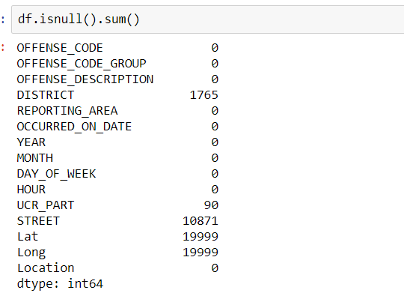
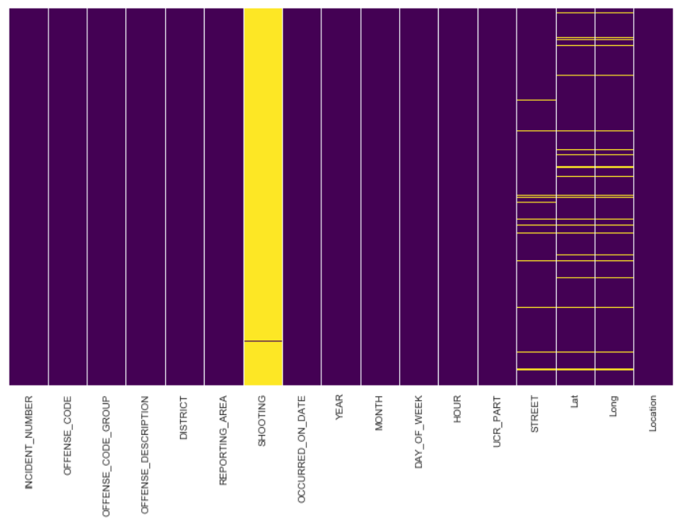
Null values handles
Visualize the null values

Slide 10
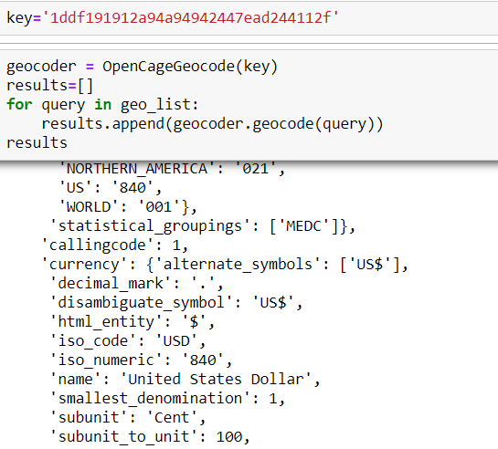
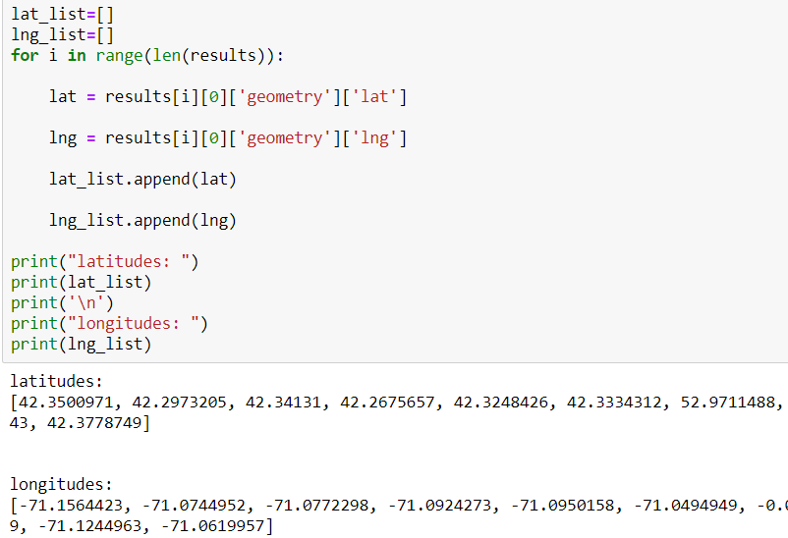
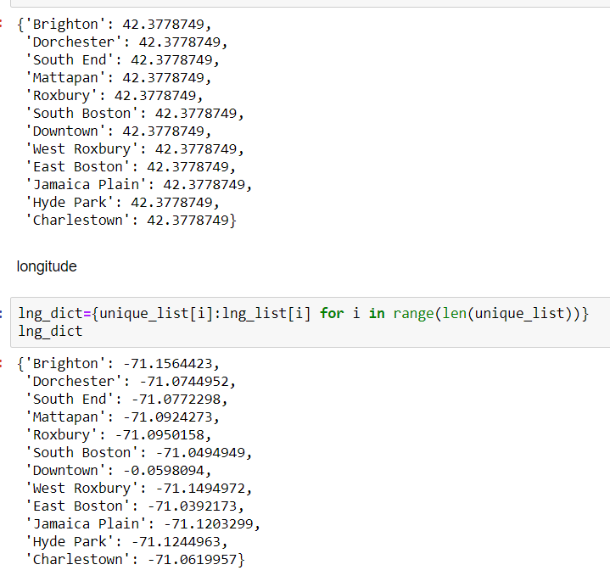
Null values handles
Web Scrape for geographic Coordinates

Slide 11
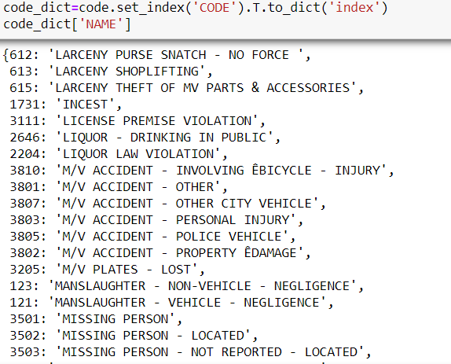
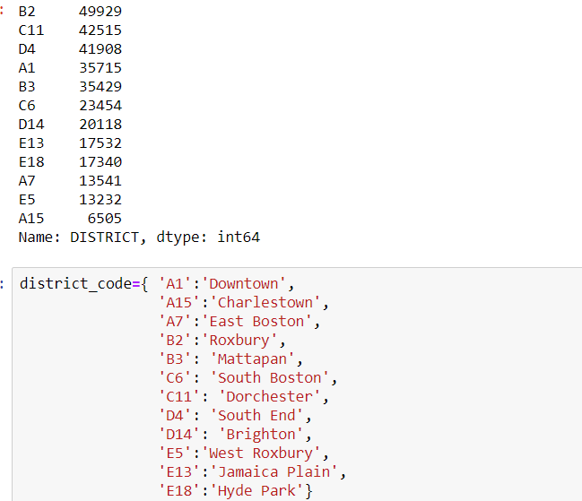
Info Mapping

Slide 12
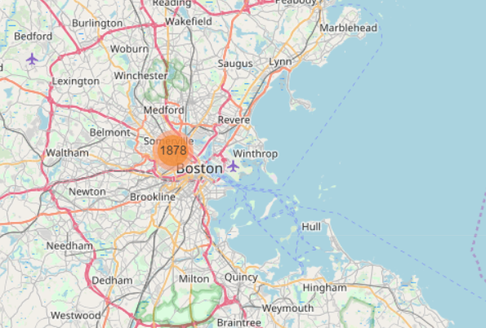
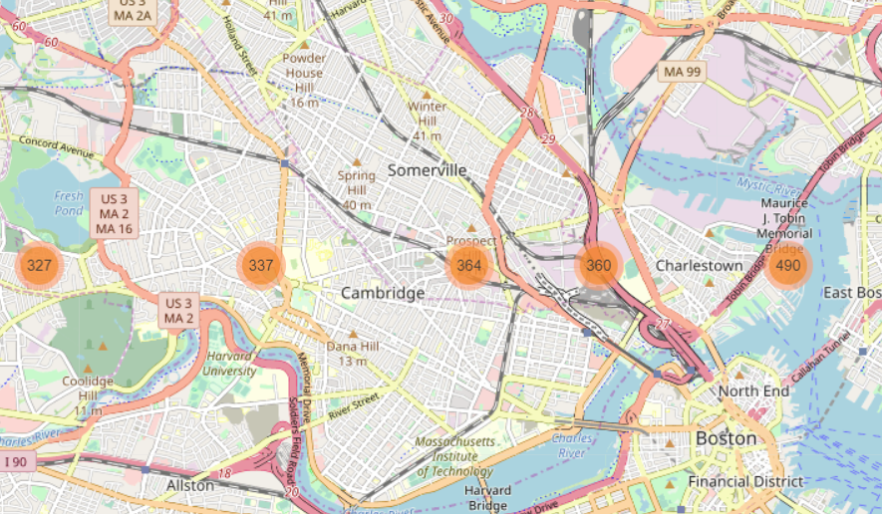
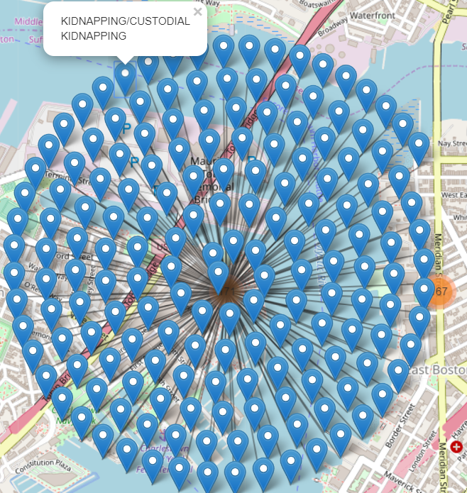
Exploratory Data Analysis
Visualize Crime Data on Folium Map

Slide 13
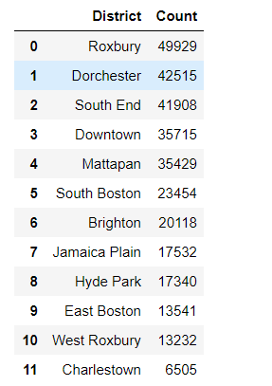
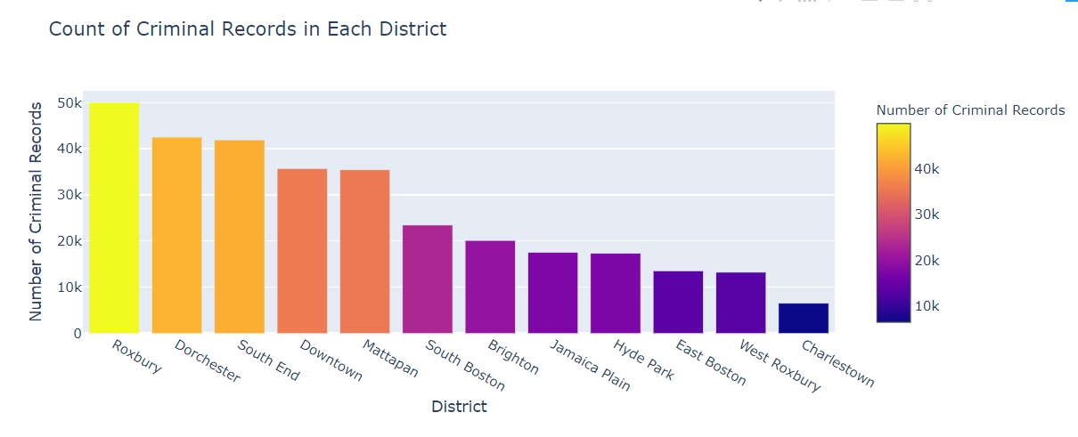
Exploratory Data Analysis
Number of Criminal Activities per District (Top 10)

Slide 14
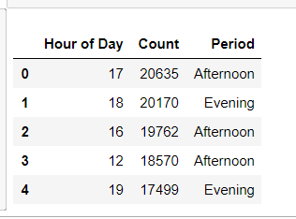
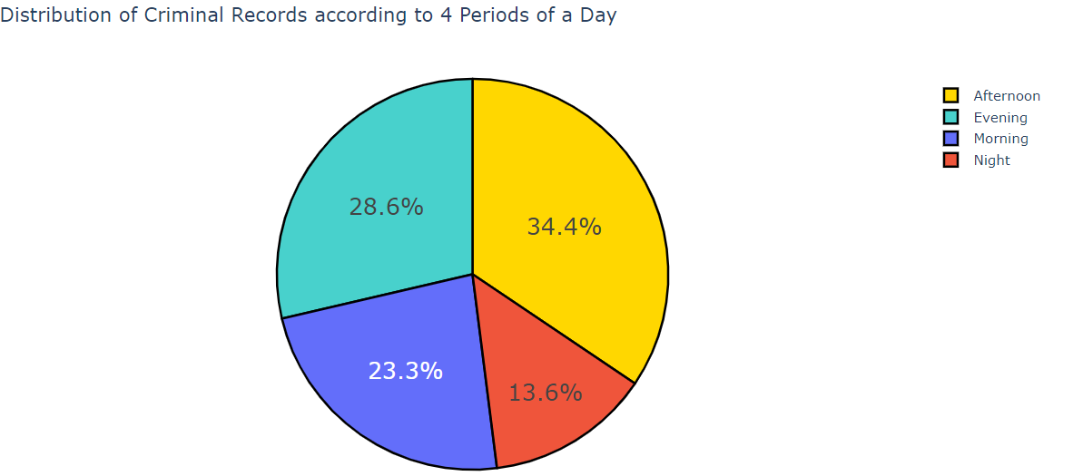
Exploratory Data Analysis
Proportion of Crime Activities Based on 4 Different Period of a Day

Slide 15
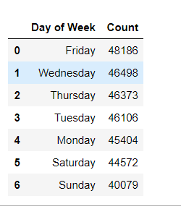
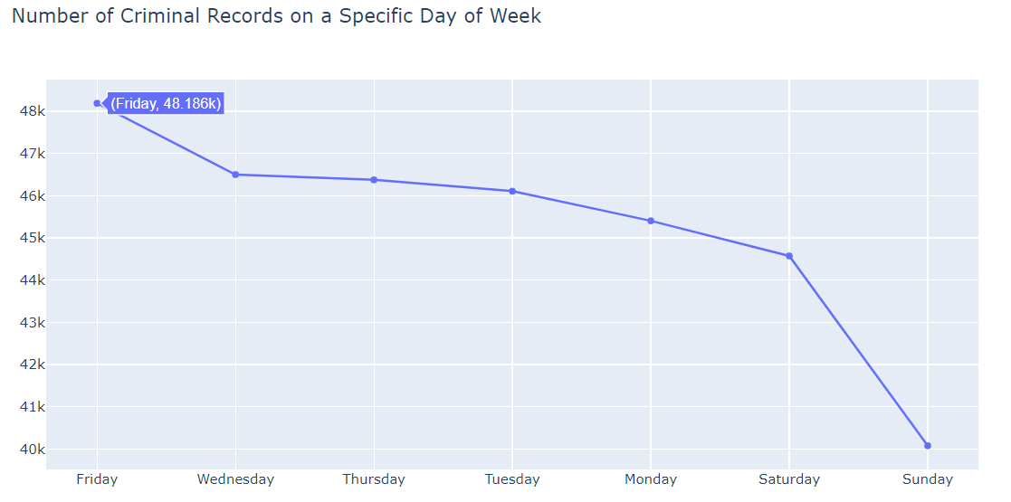
Exploratory Data Analysis
Number of Crime Activities per Day of Week

Slide 16
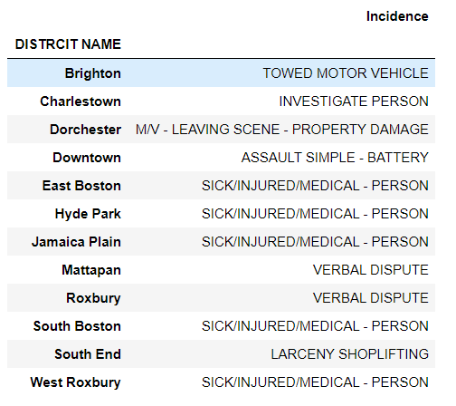
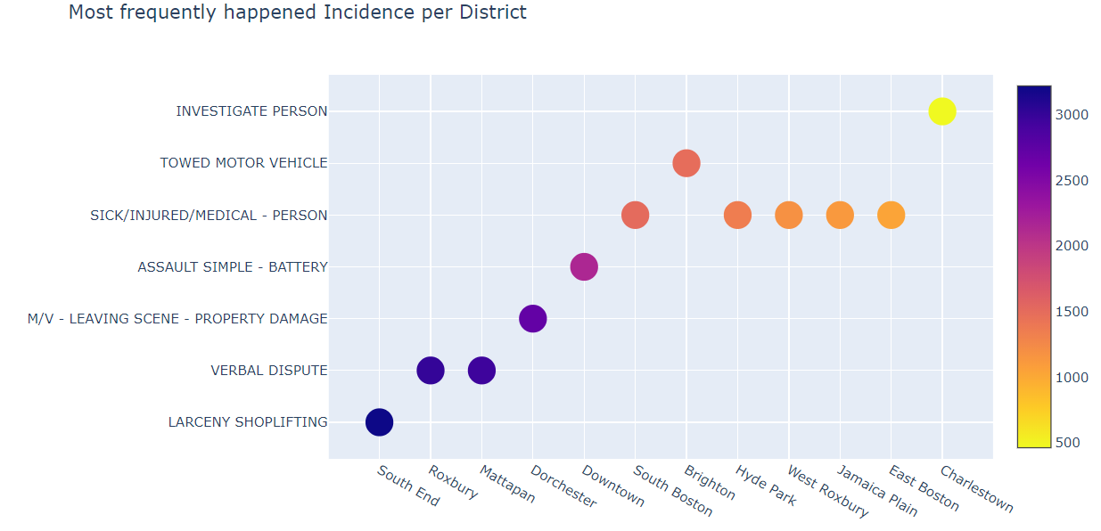
Exploratory Data Analysis
Most Frequently Happened Incidence per District

Slide 17
ML - Preprocessing
Feature Engineering &
Label Encoding each variables
One Hot Encoding variables
Balancing imbalance data
Applied Algorithms
K-means
KNN
Naïve Bayes
Random Forest
SVM
Grid Search (find best parameters)

Slide 18
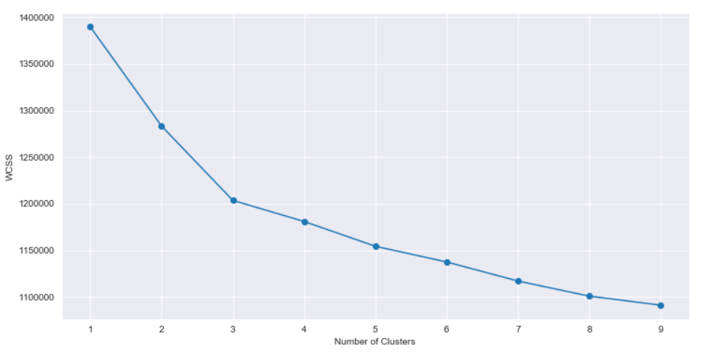
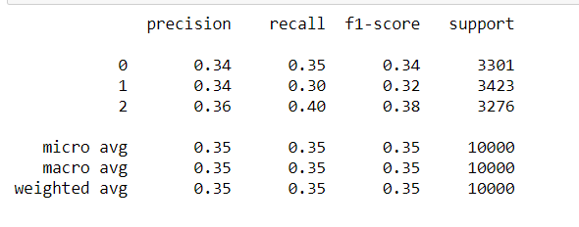
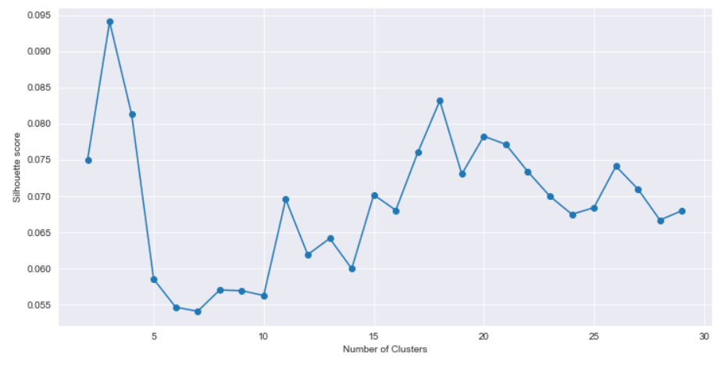
ML – Clustering (K-Means)
Elbow (K=3) / Silhouettes (K=3)
Accuracy

Slide 19
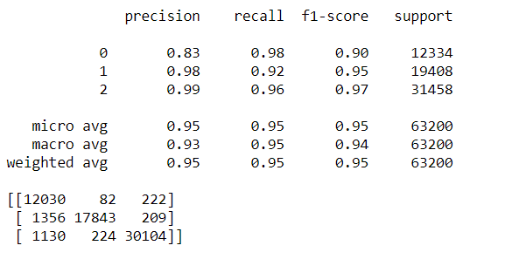
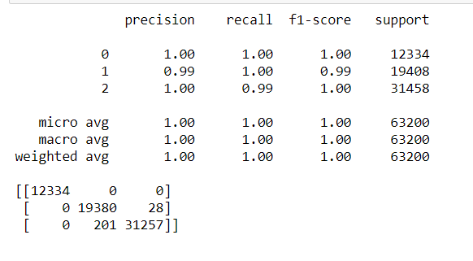
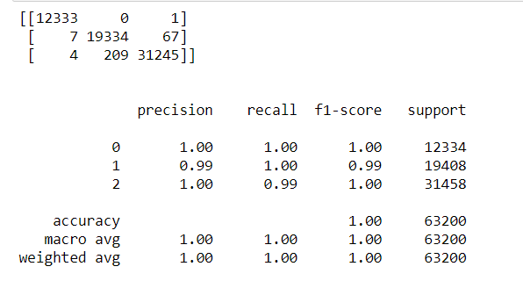
ML Classifications
KNN
Naïve Bayes
Random Forest

Slide 20
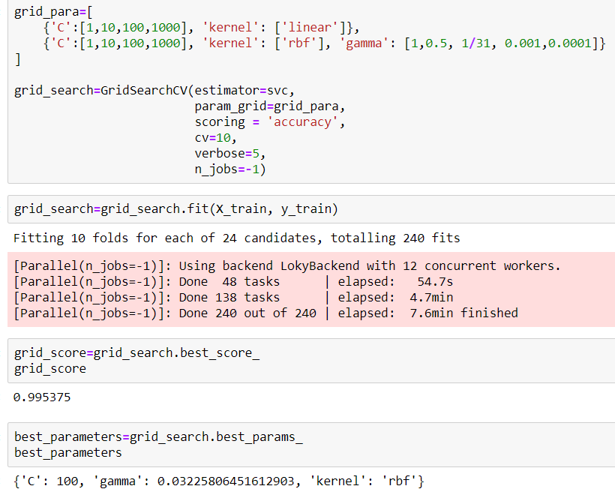
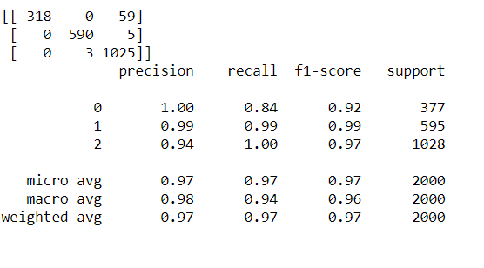
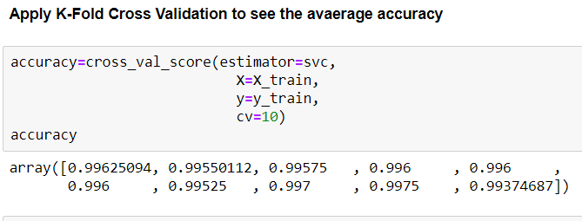
SVM & Grid Search
K-Fold
Grid Search
SVM

Slide 21
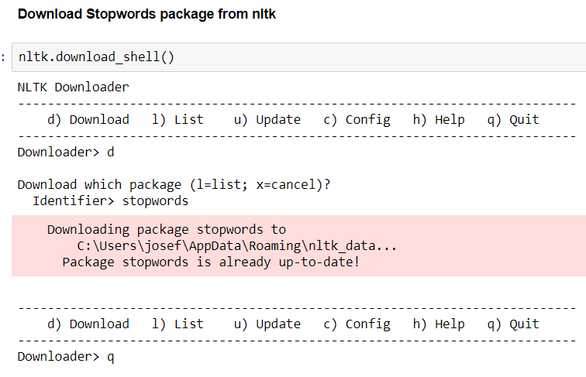
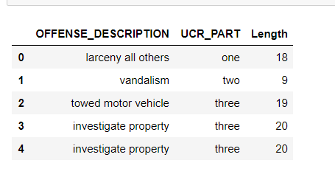
ML NLP
Download stop words package from NLTK
Formalize the data columns, only keeping descriptions & UCR Labels

Slide 22
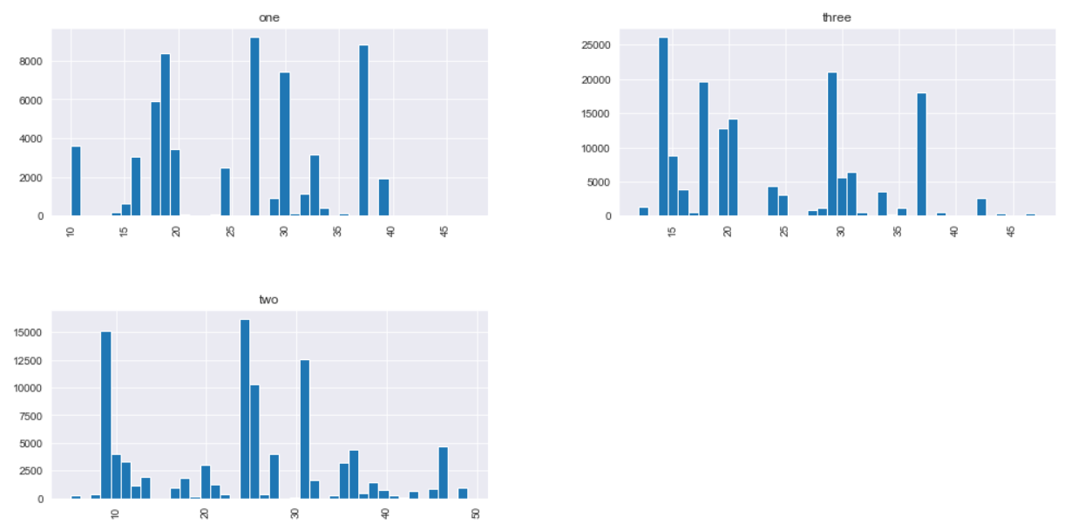
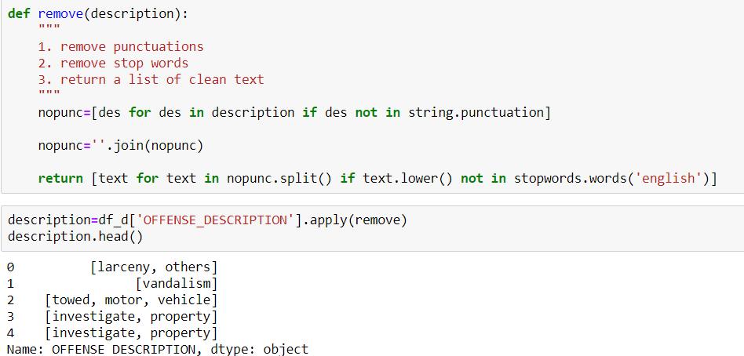
ML NLP
Explore the distribution of text’ length
Data Preprocessing

Slide 23
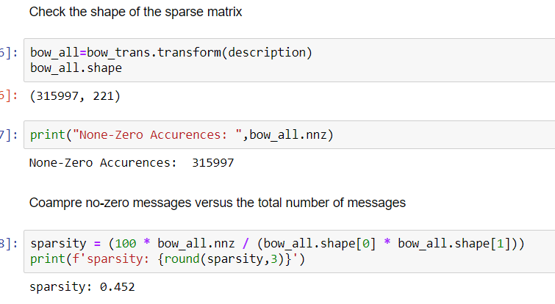
ML NLP
Bag of Words Model
Apply Counter Vectorizer to generate sparse matrix
Sparse Matrix Information

Slide 24
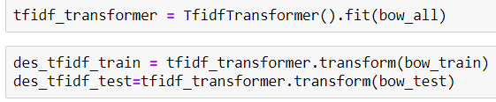
ML NLP
TF-IDF
TF: Term Frequency, measuring times each term occurs in a document
IDF: Inverse Document Frequency, measuring term’s importance.
IDF=ln(Total Number of Documents/
Number of Documents with term in it)

Slide 25
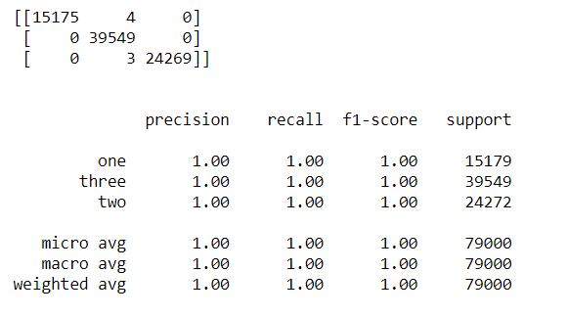
ML NLP
Multinomial Naïve Bayes

Slide 26
Time Series Analysis
Data Resample & Visualization
Moving Average Analysis (SMA, EMWA)
General Forecast Model
Deep Learning

Slide 27
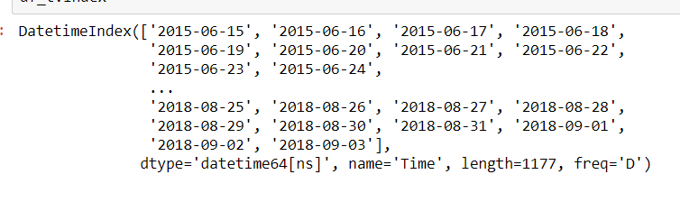
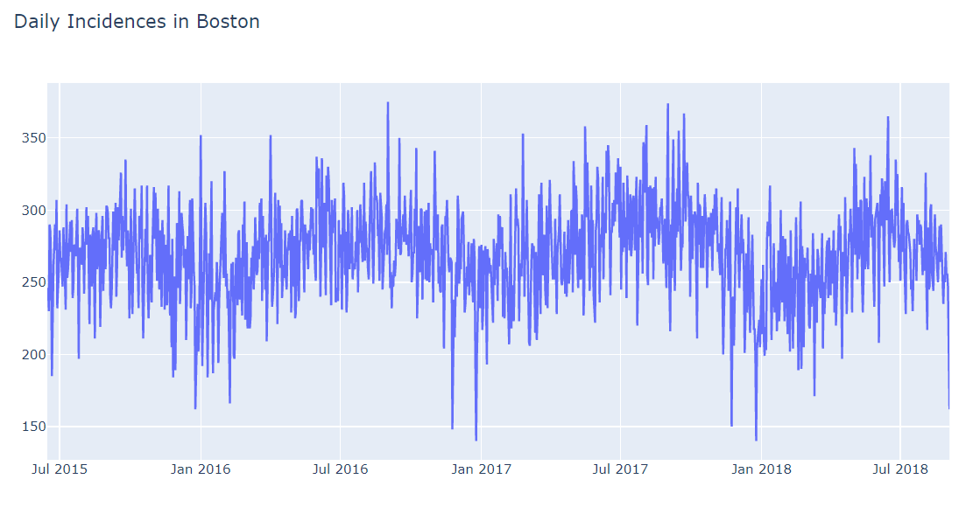
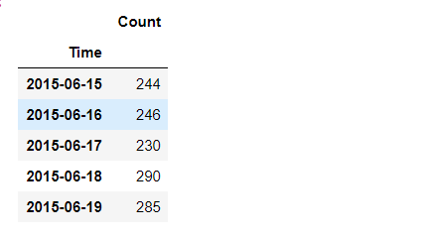
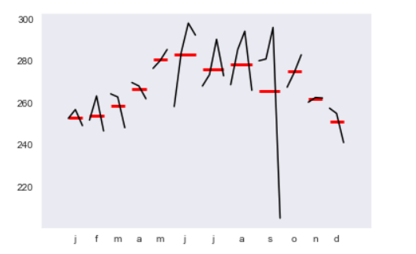
Time Series Analysis
Resample
Daily trend throughout this period

Slide 28
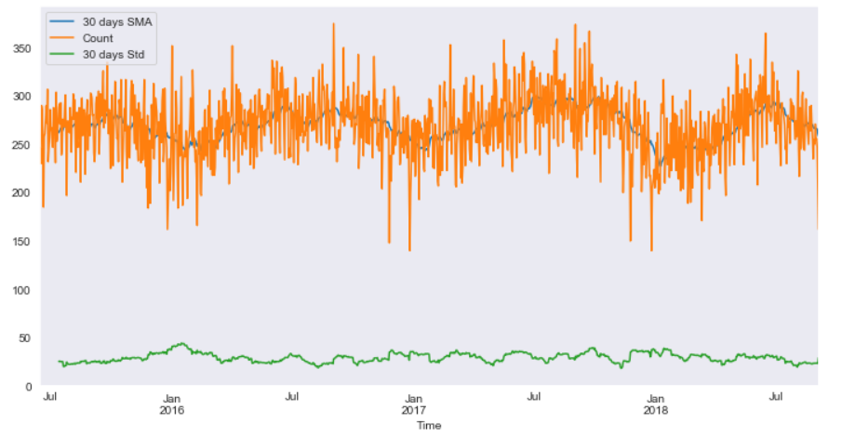
Moving Average
Simple Moving Average
Sensitive to noise
Never reach to full peak or valley of the data due to the averaging
Only for trends description
Lagged by rolling

Slide 29
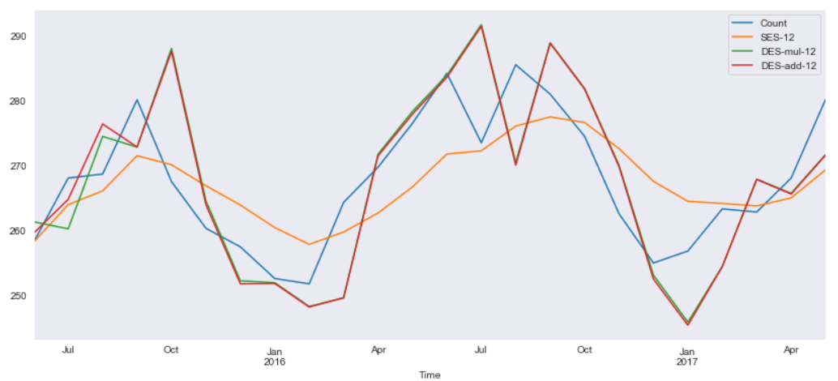
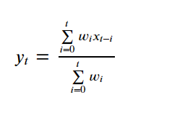
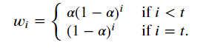
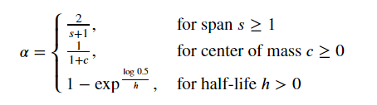
Moving Average
Exponentially Weighted Moving Average
Reduce the lag effect from SMA

Slide 30
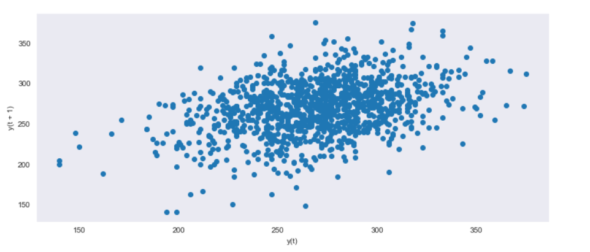
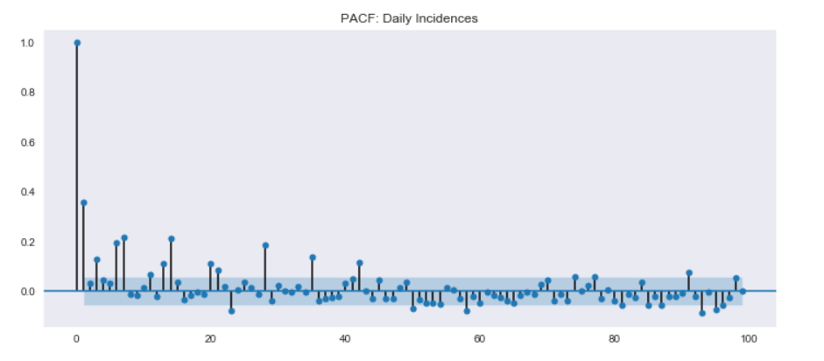
General Forecast Models
LAG plot
PACF Plot

Slide 31
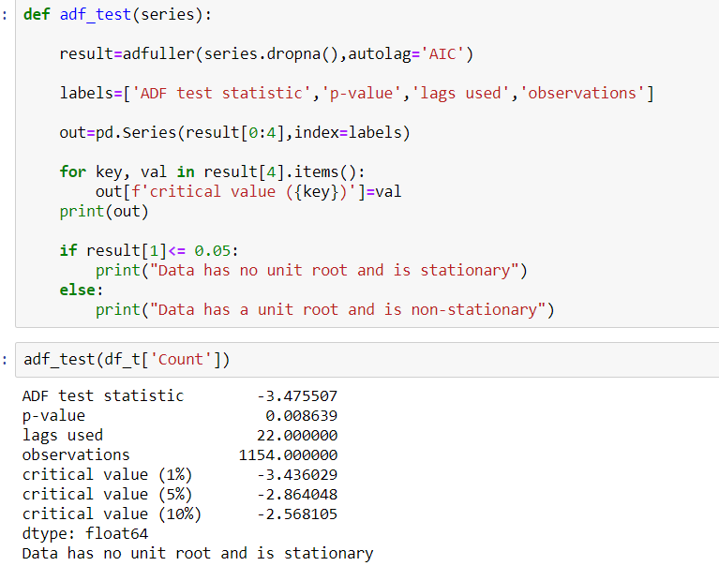
Determine Stationarity
Augmented Dickey-Fuller test

Slide 32
ARIMA
AR : Auto Regression, building the regression model off of previous values
I : Integrated Difference, differencing data from non-stationary to stationary
MA : Moving Average, indicating regression error

Slide 33
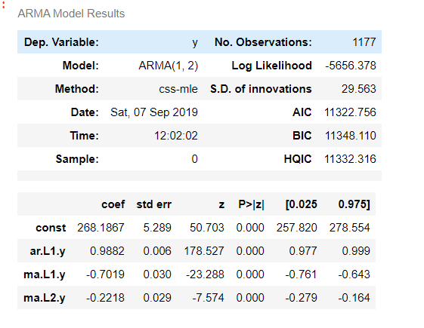
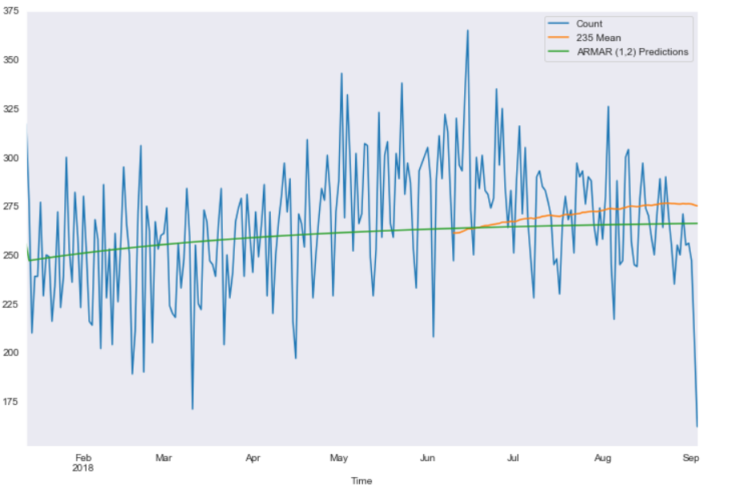
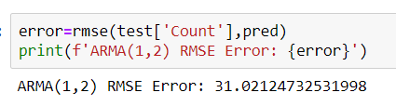
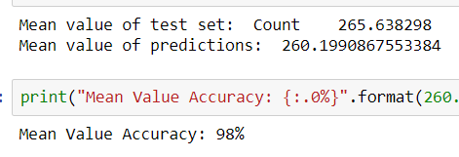
ARIMA
Summary
Visualization
Performance Evaluation

Slide 34



Deep Learning
Normalize data
Neural Network
Learning Process

Slide 35



Deep Learning
Loss Function
Model Evaluation

Slide 36
Thank you for watching !

